Slide 1
Thoroughly
Modern
Mongo
Bernard Gorman
Server Query Team, Dublin

Slide 2
Introduction
Member of the Server Query Team, Dublin
Responsible for:
CRUD execution path, built on top of the storage layer and platform infrastructure
Provide the query interface used by replication and DS for local reads and writes
Any logic which inspects or manipulates the contents of user data
Specific areas include:
Query planning, optimization, and execution
Aggregation framework
Non-materialized read-only views
Geospatial and full-text search
Update subsystem and insert/delete paths
All distributed CRUD paths on mongoS
Query logging and profiling
Introspection (explain, currentOp, index stats)
Document validation
Collation

Slide 3
Overview
Motivations
Why prioritize modern C++?
What, When and How
Timeline of Modernization Work
Making the Switch
Query Team Examples
Cases where modern C++ made the difference
Future Work
Ongoing efforts
Questions!

Slide 4
Motivations
Easier to write reliably correct code
unique_ptr, shared_ptr
Thing(): Thing(0)
Encourages a more idiomatic coding style
std::all_of(t.begin(), t.end(), [](const auto& e){ return e.isTrue(); });
Brevity => Readability + Maintainability
std::pair<BSONObj, std::set<string>> shardKeyDetails = extractShardKeyFromDoc(doc);
auto shardKeyDetails = extractShardKeyFromDoc(doc);
Performance improvements
Implicit move, NRVO fallback (C++11)
Return by converting move constructor (C++14)
Explicit std::move where appropriate
Developer Satisfaction & Productivity
More pleasant to write!

Slide 5
Modernization Timeline
Subtitle
commit e73188b5512c82290a4070af4afddac20d0b981e
Author: Dwight <dmerriman@gmail.com>
Date: Fri Oct 19 19:35:48 2007 -0400
first commit
C++98 Compatible
Builds with C++11
gcc/clang/msvc
Requires C++11
Backported to 3.0
C++14 Planning Begins
August 2011
C++11 Approved
August 2014
C++14 Approved
October 2007
First MongoDB Commit
April 2014
MongoDB 2.6
December 2015
MongoDB 3.2
auto
for x : y
{{{}}}
T&&
std::move
[&](){}
constexpr
nullptr
Thing(): Thing(0)
auto f()
[&](auto& x){}
auto x = 0b100'0001
noexcept
constexpr++
Disclaimer

Slide 6
Modernization Timeline
Subtitle
auto [x,y] = …
std::optional<T>
if (auto val; …)
constexpr if()
std::set<Type>(10, “a”)
template<typename …Args>
Requires C++14
GCC 6/7
???
December 2017
MongoDB 3.6
???
MongoDB 4.2
December 2017
C++17 Approved
Summer 2018
MongoDB 4.0
Late 2020
C++20 Approved
Requires C++14
Interim C++17 Polyfills
GCC 5
Requires C++17
GCC 6/7
Disclaimer

Slide 7
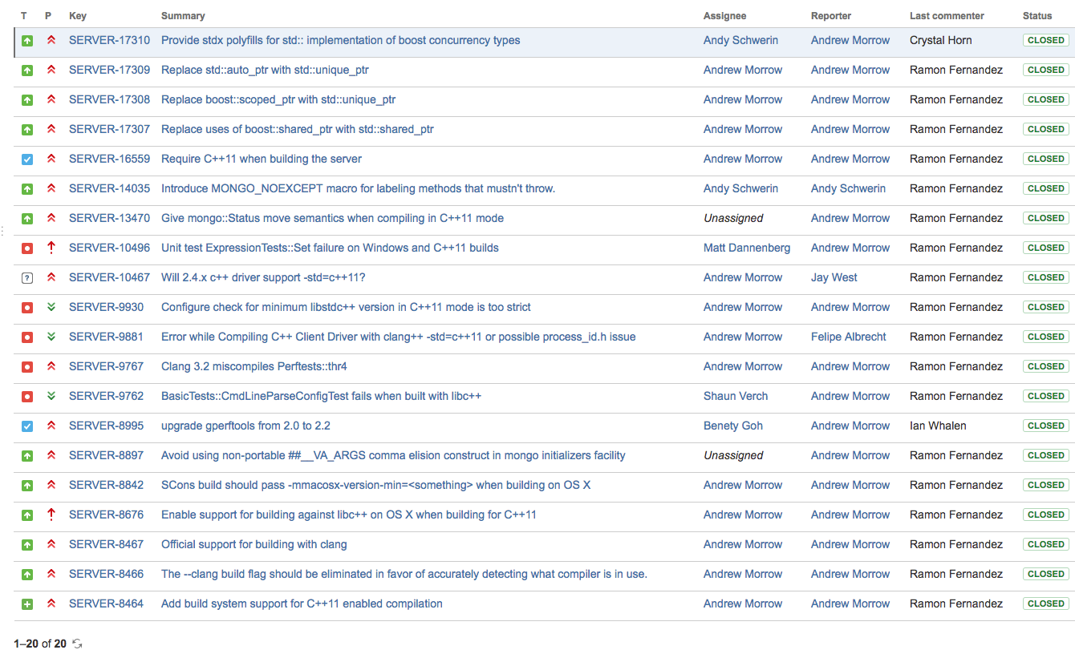
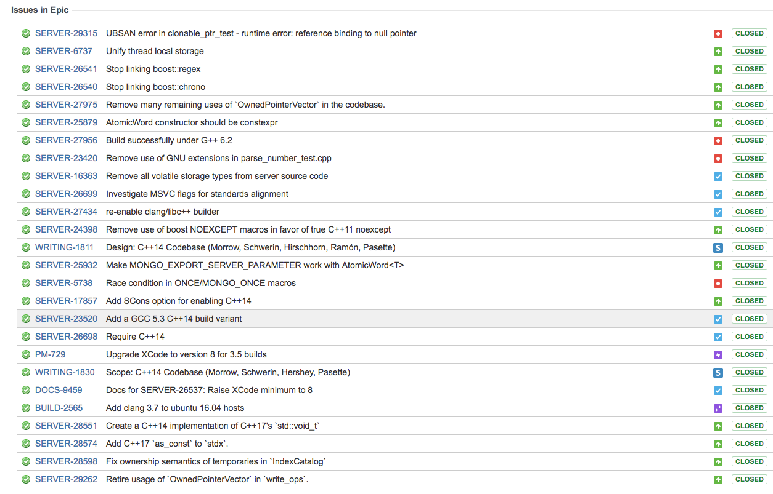
Making the Switch
Managed by Platforms Team
Responsible for Server development toolchain and ecosystem
In-house C++ standards and practices expert group

Slide 8
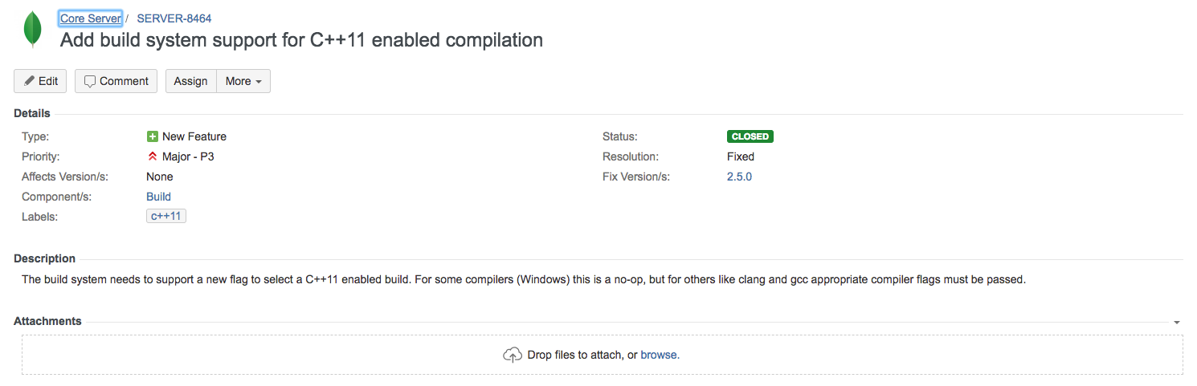
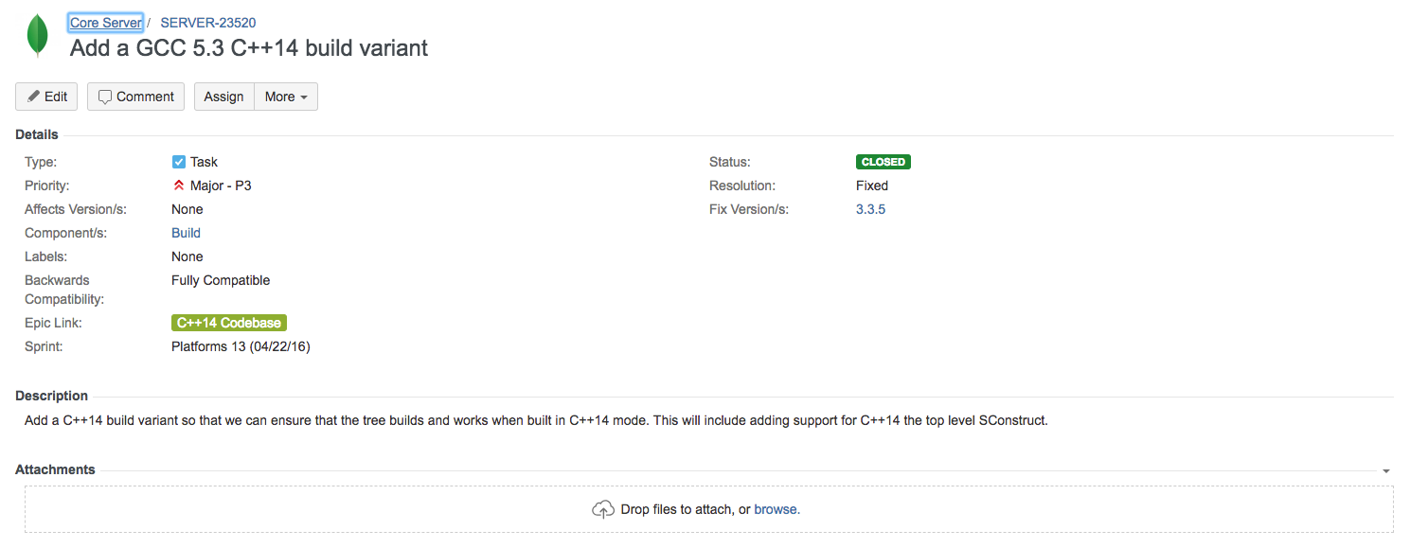
Making the Switch
General Procedure:
Introduce option to build against next standard in the dev cycle preceding the targeted release
Add build variant to our CI system, address any incompatibilities that arise
Pull forward features which may be of use, ease eventual transition

Slide 9
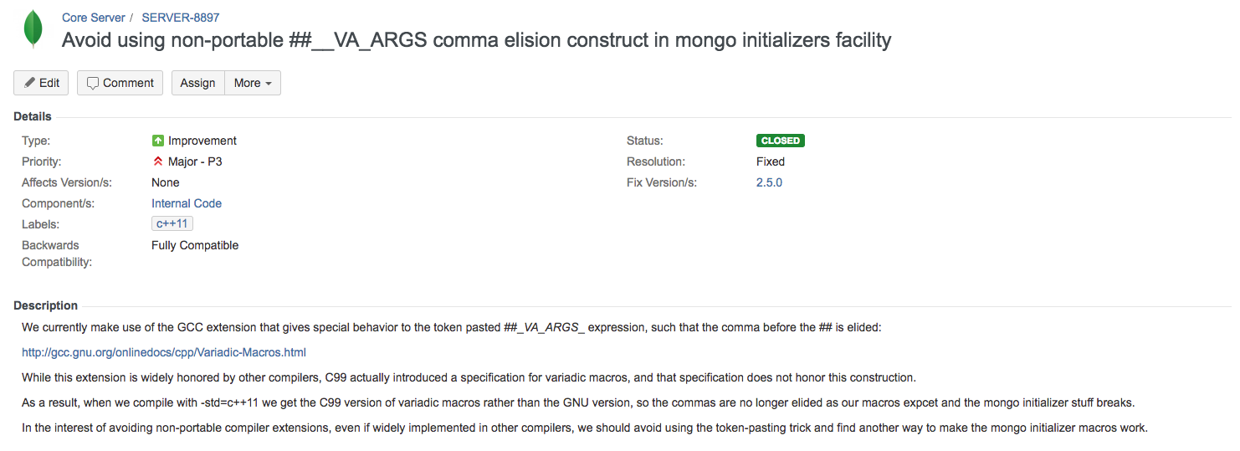
Making the Switch
General Procedure:
Introduce option to build against next standard in the dev cycle preceding the targeted release
Add build variant to our CI system, address any incompatibilities that arise
Pull forward features which may be of use, ease eventual transition

Slide 10
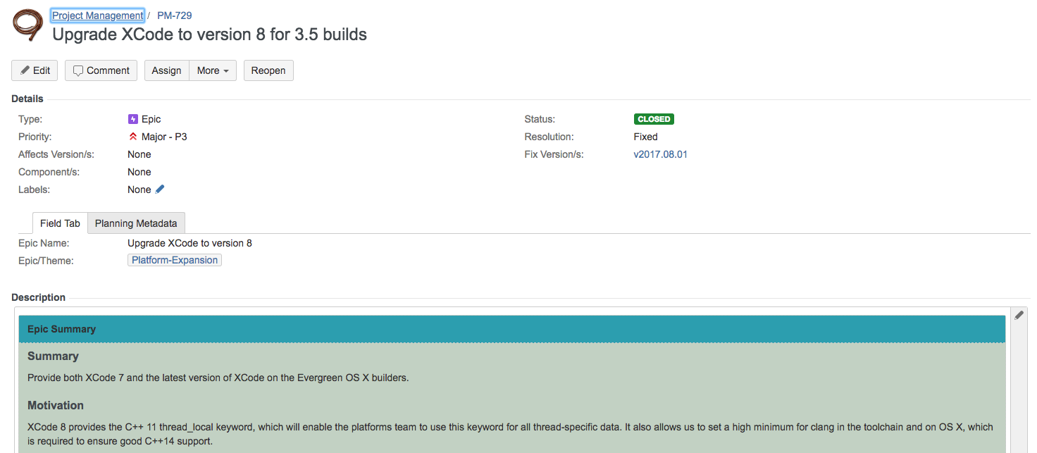
Making the Switch
General Procedure:
Introduce option to build against next standard in the dev cycle preceding the targeted release
Add build variant to our CI system, address any incompatibilities that arise
Pull forward features which may be of use, ease eventual transition

Slide 11
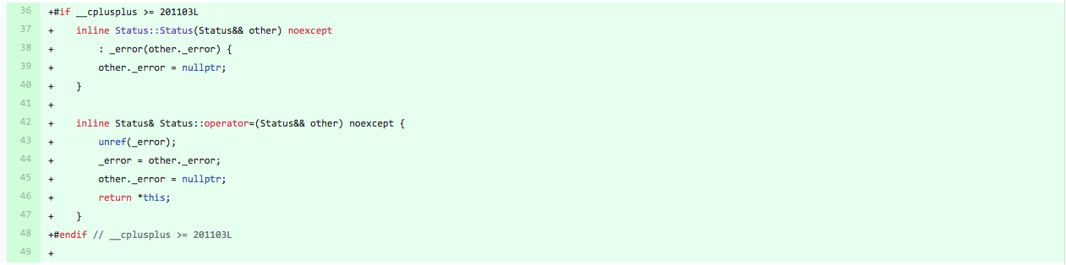
Making the Switch
General Procedure:
Introduce option to build against next standard in the dev cycle preceding the targeted release
Add build variant to our CI system, address any incompatibilities that arise
Pull forward features which may be of use, ease eventual transition

Slide 12
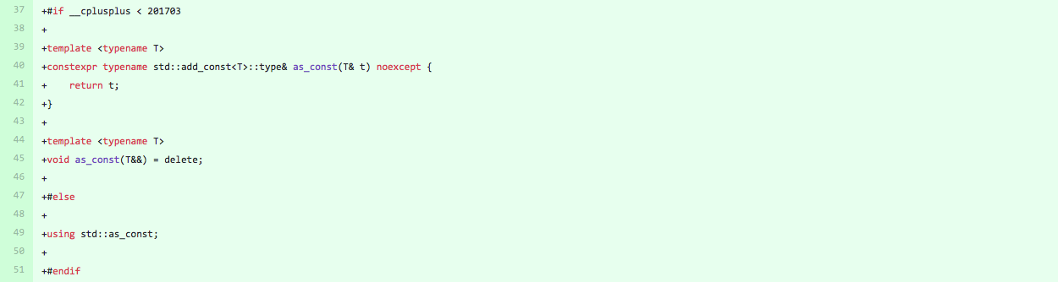
Making the Switch
General Procedure:
Introduce option to build against next standard in the dev cycle preceding the targeted release
Add build variant to our CI system, address any incompatibilities that arise
Pull forward features which may be of use, ease eventual transition

Slide 13
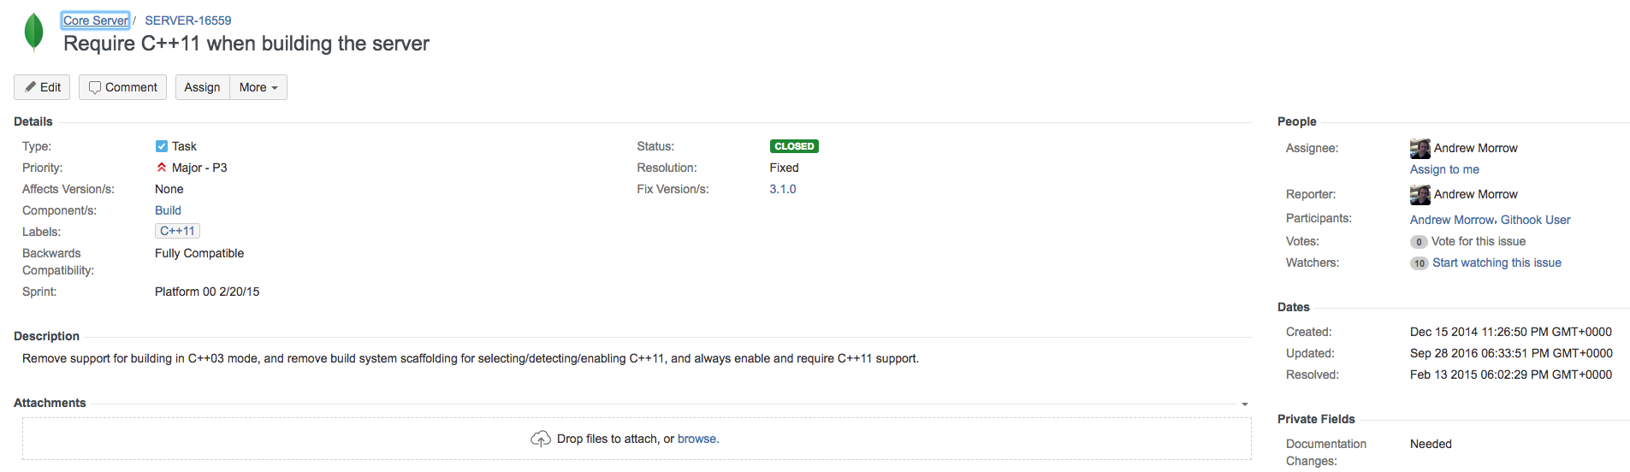
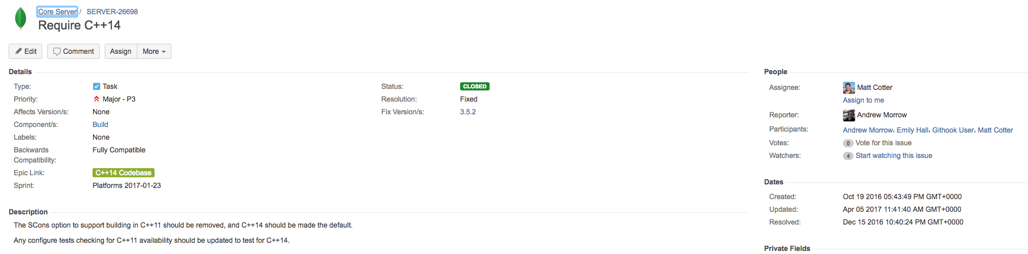
Making the Switch
Remove support for the older standard early in the development cycle for the targeted release
After we branch from the new GA release, on which we have been testing for ~1 year
Some time thereafter, begin adding support for next standard

Slide 14

Making the Switch
Replace or polyfill any features that have been obviated by the standard library
Migrate boost::xyz to stdx::xyz, provide std and boost implementations
Guard against incomplete support on certain platforms, useful level of indirection
Replace pulled-forward features with their standard counterparts
Bring sections of the codebase owned by Platform up to the new standard
Goal: update as much code as makes sense, while avoiding unnecessary churn

Slide 15
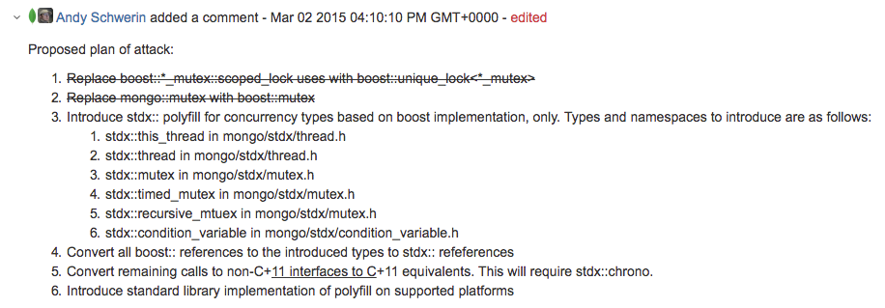
Making the Switch
Replace or polyfill any features that have been obviated by the standard library
Migrate boost::xyz to stdx::xyz, provide std and boost implementations
Guard against incomplete support on certain platforms, useful level of indirection
Replace pulled-forward features with their standard counterparts
Bring sections of the codebase owned by Platform up to the new standard
Goal: update as much code as makes sense, while avoiding unnecessary churn

Slide 16
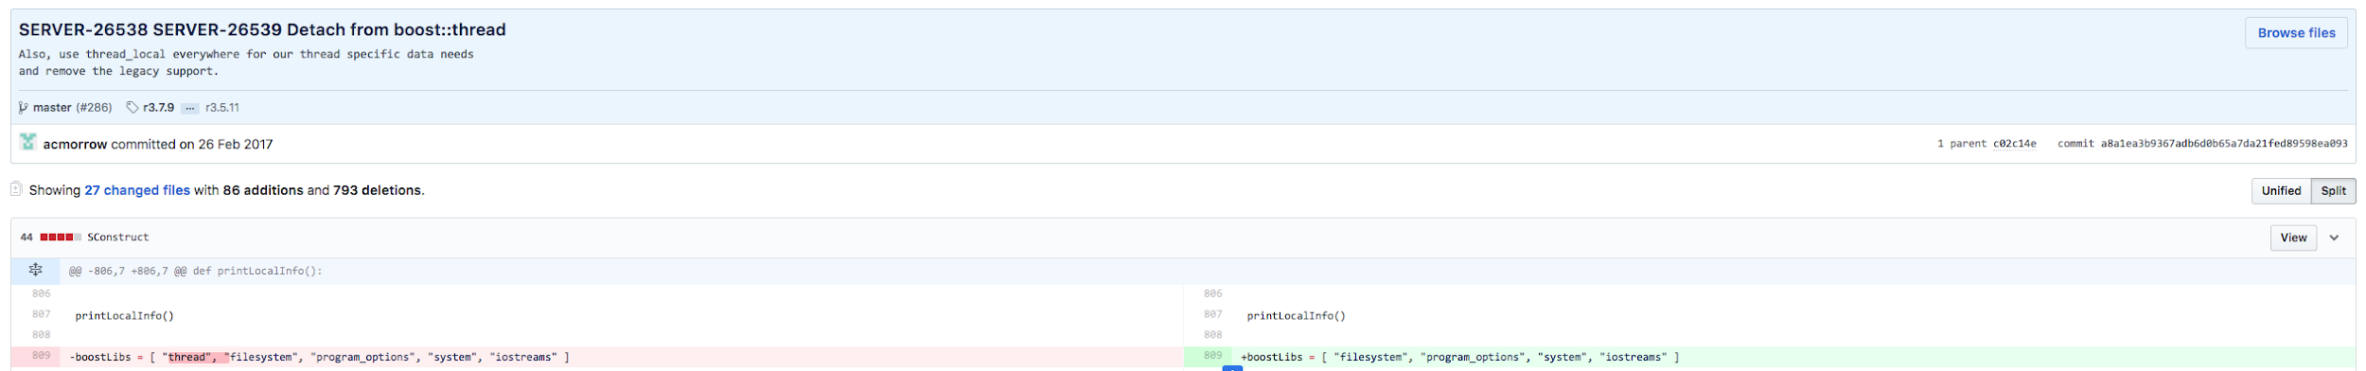
Making the Switch
Replace or polyfill any features that have been obviated by the standard library
Migrate boost::xyz to stdx::xyz, provide std and boost implementations
Guard against incomplete support on certain platforms, useful level of indirection
Replace pulled-forward features with their standard counterparts
Platform brings certain sections of the codebase up to the new standard
Goal: update as much code as makes sense, while avoiding unnecessary churn

Slide 17
Making the Switch
Finally:
Update linting rules to ban anything that can be (within reason)
Ensure that new code refers to polyfills rather than explicitly calling boost
Encourage other teams to incrementally modernize their areas of responsibility

Slide 18
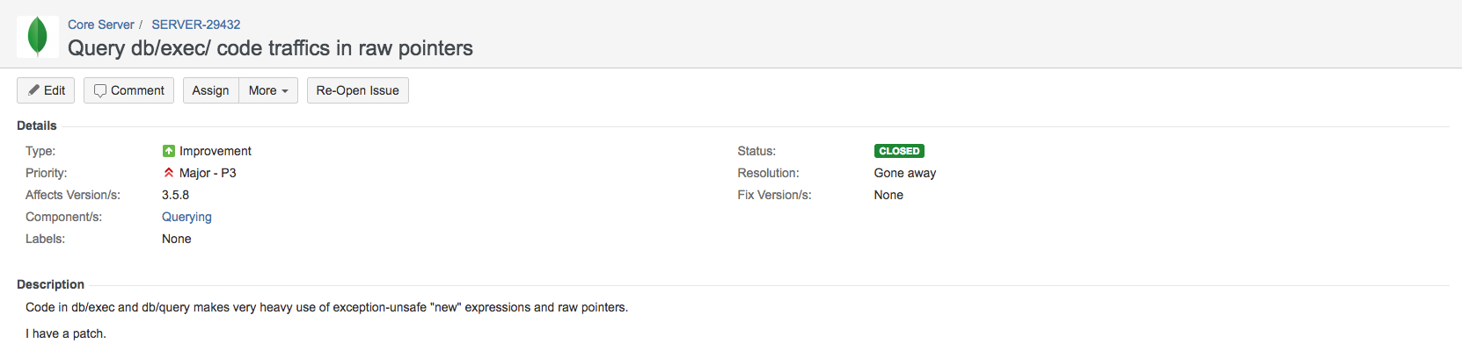
Making the Switch
Finally:
Update linting rules to ban anything that can be (within reason)
Ensure that new code refers to polyfills rather than explicitly calling boost
Encourage other teams to incrementally modernize their areas of responsibility

Slide 19
Query System Modernization

Slide 20
Query System Modernization
Incremental Modernization
After Platform’s initial updates, modernization proceeds incrementally
Want to avoid churning stable, tenured areas of the codebase all at once
Explicit modernization / tech debt work is sometimes scheduled
Otherwise, incremental changes driven by several factors:
Performance
Correctness
Opportunity
Necessity
Convenience

Slide 21
Query System Modernization
Problem: blocking sort
Required when there is no appropriate index to serve the user’s request
Generating sort keys from the set of matched documents is slow
Profiling revealed that this dominates the total runtime of the operation

Slide 22
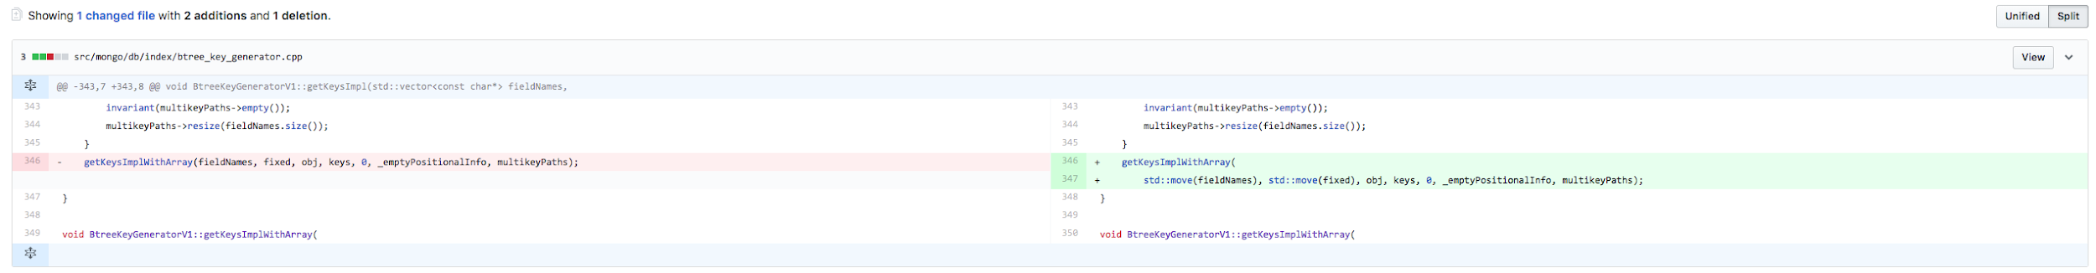
Query System Modernization
Problem: blocking sort
Required when there is no appropriate index to serve the user’s request
Generating sort keys from the set of matched documents is slow
Profiling revealed that this dominates the total runtime of the operation

Slide 23
Query System Modernization
Problem: blocking sort
Required when there is no appropriate index to serve the user’s request
Generating sort keys from the set of matched documents is slow
Profiling revealed that this dominates the total runtime of the operation
Saves two vector copies and calls to tcmalloc delete
Improved performance of large-scale sorts by up to 40% (300ms vs 500ms)

Slide 24
Query System Modernization
Query Planner/Executor
One of the core components of MongoDB
Relatively old, tenured code, stable
Traffics in raw pointers; occasional ASAN + Fuzzer leaks

Slide 25
Query System Modernization
Query Planner/Executor
One of the core components of MongoDB
Relatively old, tenured code, stable
Traffics in raw pointers; occasional ASAN + Fuzzer leaks
[ShardedClusterFixture:job0:shard1] =================================================================
[ShardedClusterFixture:job0:shard1] ==31566==ERROR: LeakSanitizer: detected memory leaks
[ShardedClusterFixture:job0:shard1]
[ShardedClusterFixture:job0:shard1] Direct leak of 40 byte(s) in 1 object(s) allocated from:
[ShardedClusterFixture:job0:shard1] #0 0x559e5e80320b in operator new(unsigned long) /data/mci/c5d8f4120437056d97d16d15cf65c6ac/toolchain-builder/llvm/projects/compiler-rt/lib/asan/asan_new_delete.cc:78:35
[ShardedClusterFixture:job0:shard1] #1 0x559e6249d5b7 in mongo::QueryPlannerAnalysis::analyzeDataAccess(mongo::CanonicalQuery const&, mongo::QueryPlannerParams const&, std::unique_ptr<mongo::QuerySolutionNode, std::default_delete<mongo::QuerySolutionNode> >) /data/mci/02eca4160258687300c9c4067ba049b4/src/src/mongo/db/query/planner_analysis.cpp:623:36
[ShardedClusterFixture:job0:shard1] #2 0x559e624bfff5 in mongo::QueryPlanner::plan(mongo::CanonicalQuery const&, mongo::QueryPlannerParams const&, std::vector<mongo::QuerySolution*, std::allocator<mongo::QuerySolution*> >*) /data/mci/02eca4160258687300c9c4067ba049b4/src/src/mongo/db/query/query_planner.cpp:898:17
[ShardedClusterFixture:job0:shard1] #3 0x559e5f7dc539 in mongo::(anonymous namespace)::prepareExecution(mongo::OperationContext*, mongo::Collection*, mongo::WorkingSet*, std::unique_ptr<mongo::CanonicalQuery, std::default_delete<mongo::CanonicalQuery> >, unsigned long) /data/mci/02eca4160258687300c9c4067ba049b4/src/src/mongo/db/query/get_executor.cpp:385:21

Slide 26
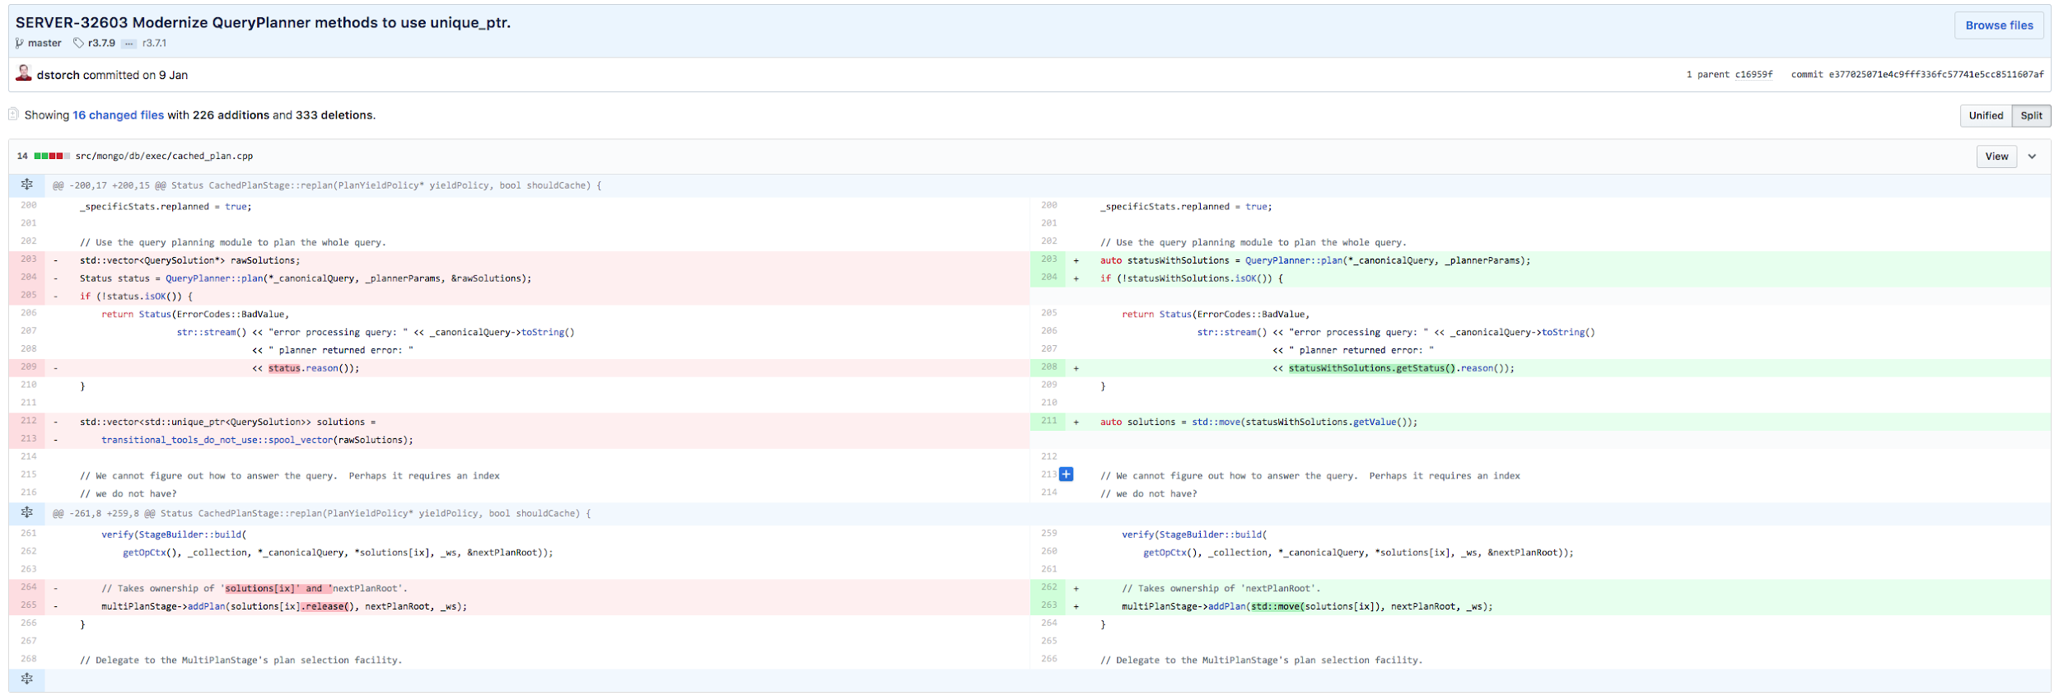
Query System Modernization
Query Planner/Executor
One of the core components of MongoDB
Relatively old, tenured code, stable
Traffics in raw pointers; occasional ASAN + Fuzzer leaks

Slide 27
Query System Modernization
ViewCatalog
Holds read-only view metadata (name, pipeline, underlying collection)
New views typically added via create command
But it’s also possible to insert view definitions directly into system.views
Latter use-case leads to unexpected synchronization problem:
Thread A calls ViewCatalog::lookup() and obtains a ViewDefinition*
Thread A holds a MODE_IS lock while using ViewDefinition*
Thread B inserts a valid view directly into system.views
Possible because B’s insert acquires MODE_IX lock, rather than the create command’s MODE_X lock
ViewCatalog::_valid is marked false.
Thread C calls any method of ViewCatalog, which implicitly reloads the catalog
Clears the old ViewMap and releases all of the ViewDefinitions.
All iterators to the old ViewMap are now invalidated and all the ViewDefinition pointers have been freed
However, Thread A may attempt to use its ViewDefinition*, resulting in undefined behavior.

Slide 28
Query System Modernization
ViewCatalog
Holds read-only view metadata (name, pipeline, underlying collection)
New views typically added via create command
But it’s also possible to insert view definitions directly into system.views
Latter use-case leads to unexpected synchronization problem:
Thread A calls ViewCatalog::lookup() and obtains a ViewDefinition*
Thread A holds a MODE_IS lock while using ViewDefinition*
Thread B inserts a valid view directly into system.views
Possible because B’s insert acquires MODE_IX lock, rather than the create command’s MODE_X lock
ViewCatalog::_valid is marked false.
Thread C calls any method of ViewCatalog, which implicitly reloads the catalog
Clears the old ViewMap and releases all of the ViewDefinitions.
All iterators to the old ViewMap are now invalidated and all the ViewDefinition pointers have been freed
However, Thread A may attempt to use its ViewDefinition*, resulting in undefined behavior.
Solution: Refactor ViewCatalog to use shared_ptr throughout
Allows checked-out ViewDefinitions to persist through a reload
Correct even if view is removed, since it was present at the time the thread acquired the ViewDefinition*

Slide 29
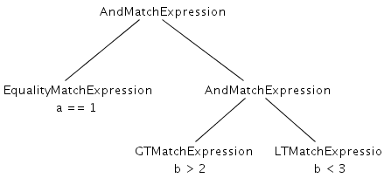
Query System Modernization
MatchExpression::optimize()
AST produced by parsing the client’s query
Each type of node admits to a set of potential optimizations
Absorb grandchildren, prune redundant branches, etc
All optimization logic was in owning CanonicalQuery
Knowledge of all MatchExpression subclass’ optimizations
Project: More Expressive $lookup (3.6)
Define pipeline on foreign collection, $expr in MatchExpression
Need to call optimize() on MatchExpression and have the optimization percolate through the tree
All optimization logic should be internal to each MatchExpression
Problem: optimize could result in a node “removing itself” from the tree
Automatic destruction required => unique_ptr
But cannot define member function that accepts unique_ptr this

Slide 30
Query System Modernization
MatchExpression::optimize()
Solution: unique_ptr, lambdas, std::function
All nodes managed by unique_ptr, auto-destruct
virtual ExpressionOptimizerFunc getOptimizer() const = 0;
std::function unique_ptr<MatchExpression> -> unique_ptr<MatchExpression>
ExpressionOptimizerFunc getOptimizer() const final {
return [](std::unique_ptr<MatchExpression> expression) { return expression; };
}
Obtain function from root MatchExpression, apply it, recurses through the tree
Each node may return same expression, mutated expression, different expression
Each MatchExpression knows only its own optimizations
Achieved desired goals of virtual dispatch + managed pointers
Allows the MatchExpression AST to be optimized in a similar manner to aggregation pipelines

Slide 31
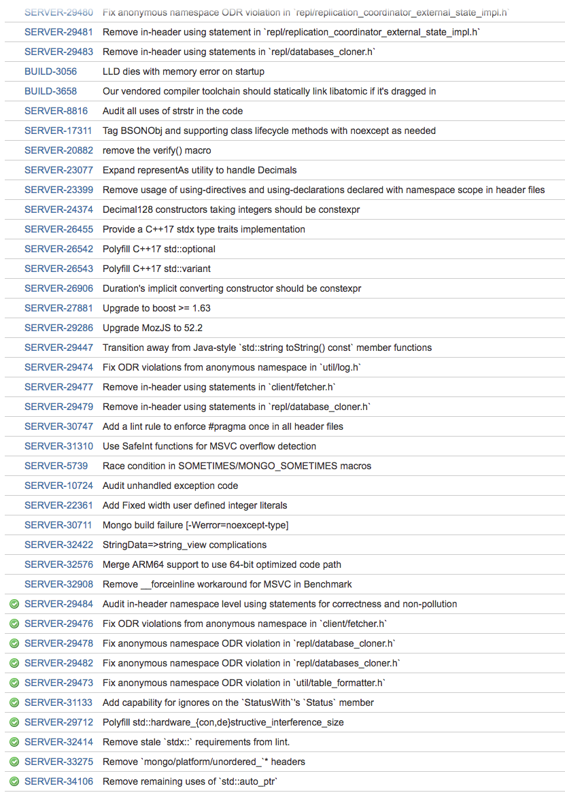
Towards C++ 17
Plans to move to C++17 are already in motion
Provisionally targeting MongoDB release 4.2
Existing mocked constructs:
std::as_const, std::void_t
Particularly looking forward to:
Automatic template type deduction!
Structured binding declaration
if/switch inline initialization
std::optional
Platform Team Estimate: “Very Soon™”

Slide 32
We’re Hiring!
Database Server Engineer, Query (Dublin)
mongodb.com/careers/departments/engineering

Slide 33
Thanks!
Questions?

